Slide 1
Social sustainability in peripheralized urban areas
Maria Vallström, ass prof. Ethnology
R&D Söderhamn/Södertörns högskola
Sustainable planning and design HT 2017

Slide 2
I: Introduction: Today’s subject
To understand territorial stigmatization and learn about methods used against it, to achieve social sustainability
Based on earlier research projects on former single industry communities (FORMAS) and on spatial stigmatization and rumour (National Board of Housing, Building & Planning)

Slide 3
Points of departure:
The spatial aspects of power
Periphery as something constructed regardless of geography – and numbers – instead being a relation of power
Reproducing periphery is made with ”help” from other dichotomies- Charles Tilly’s ”shortcuts” (Durable inequalities, 1999) f. ex. class and ethnicity, leading to segregation and inequality
”the Spacialization of social policy” as a solution to the paradox of equal citizenship and social injustice in France (Dikec) – creating spaces ”outside” the nation

Slide 4
”Advanced marginality” (Waquant)
The abandonment of (the working) class
  By society
  By researchers
  By politicians
Located in ”reservats”: Territorial stigmatization
Strategies: (Dis)identifying as inhabitants (naming another ”other”) as individual strategy for an escape from stigma
        …or moving out.

Slide 5
Implosion of the social structure in million programme era suburbs
Vanishing points:
Work/leisure dichotomy
Resources connected to workplaces
Abandoned existence:
Withdrawal of recognition (Don Kalb)

Slide 6
Sustainability: A wicked problem, a contested concept
Being highly invested in
Open for interpretation
Having a complex character

Slide 7
Social sustainability
The ”third leg” of sustainability
Research performed in (roughly) three directions:
  Development social sustainability
  Bridging social sustainability
  Maintenance social sustainability – resilience
        Vallance/Perkins/Dixon 2011

Slide 8
Today´s definition
Mostly development social sustainability – ”catching up”
On an analytical level; seeing ability for taking responsibility for a common place or issue as a necessary condition for social sustainability
Consider this responsibility as collective, socially shared practices
  Not an individual responsibility for inhabitants
  Not restricted to policy or rhetorics
    But practice

Slide 9
Today’s literature
To add some questions to think with:
  What do authorities do when they think they are ”helping” these areas?
  What is said between the lines?
  What power structures are reproduced and how?
  How is difference made?

Slide 10
Field: Peripheralized urbanities
Former single industry communities AND suburbs of the million-programme era, as peripheralized urbanities
Regarding both as being built to be modern, for a working welfare society.
Research strategies:
Making comparisons to achieve contingency in space and time
Trying to get behind ”First explanation value”

Slide 11
Sites of ethnography
Norrsundet (968 inhabitants in 2010)
Ljusne (1 917)
Hofors (6 681)
Växjö: Araby (6 386, 2013)
Kristianstad: Gamlegården (appr. 5000, 2014)
Malmö: Rosengård/Herrgården (23174/4660, 2010)
(Malmö: Södra Sofielund, 4 478, 2010)

Slide 12
II Peripheralized urbanities
1: Former single industry communities
Built to be modern in the rural landscape
Demographical decrease: almost 50 % since 1970’s
Lost employment opportunities
Dramatic decrease in service and retail
Discourse on ”company-town mentality” (bruksanda) as oppressing
Now being (transit)places for refugees

Slide 13
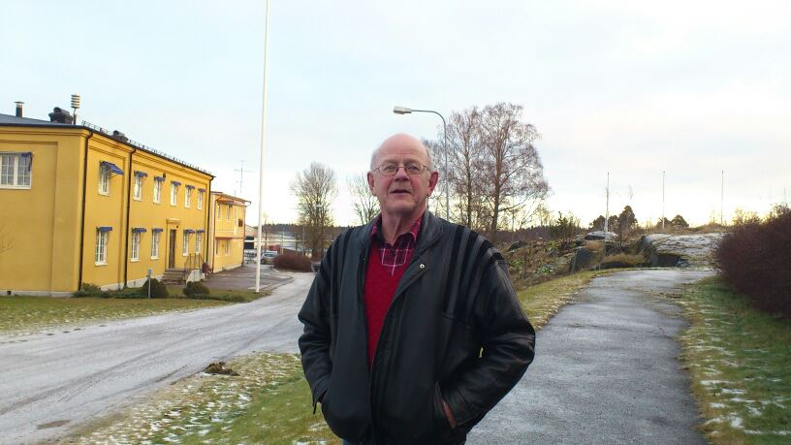
Norrsundet, Gävleborg

Slide 14
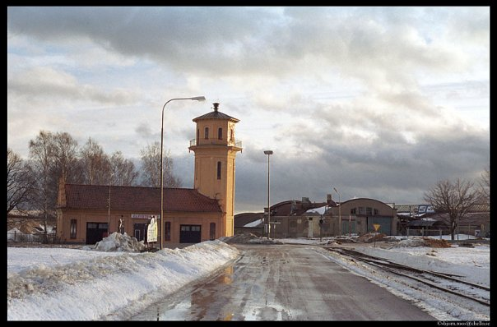
Ljusne

Slide 15
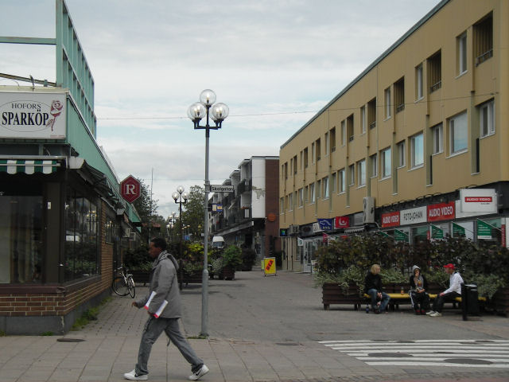
Hofors Photo: Thomas Wikstrom, Malmö Högskola

Slide 16
”Company-town mentality” (bruksanda)
As opposed to entrepreneurship
As defined by ”the Jante-Law” (Sandemose)
Has an explanatory function
Can be analyzed as myth and/or experience

Slide 17
Myth: ”Company-town mentality”
Individuals regarded as suffering from this are described as:
Lacking development, characterized by stagnation
Being ”closed” towards others (outside the local community)
Backward, nostalgic, passive
Dependence on ”the company” or, later on, the municipality

Slide 18
Experience: ”Company-town mentality”
Inhabitants themselves mention characteristics like:
Helpfulness and cohesiveness
Social control and attention
Collective organizing and acting
”The company” as a strong site of resistance and conflict, but also used as a resource by the employees.

Slide 19
Peripheralized urbanities 2: Urban development areas
15 areas for interventions, governmental definition since 2012:
Low rate of education (under 70 % got access to gymnasium)
Low rate of employment (under 52%)
Long- term social benefit caretakers (over 4,8 %)
Minimum 4000 citizens - often urban districts from the ”million program era”, located in larger cities
Stockholm: Tensta, Rinkeby, Ronna och Hovsjö

Slide 20
”Million program era”
The concept of Swedish suburbs is intertwined with the notion of the ”Million program era”:
Building a million units of housing during 1965-1974
One third were high rise multifamily housing with four stories or more, in commuter suburbs, with small centres
Becoming a symbol of the million program era and the suburb in Sweden

Slide 21
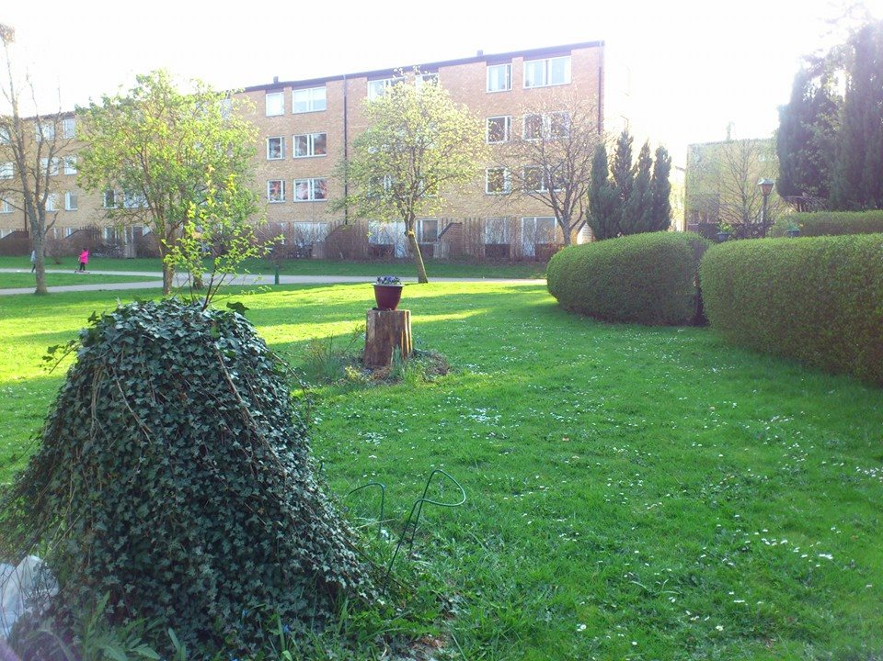
Gamlegården, Kristianstad

Slide 22
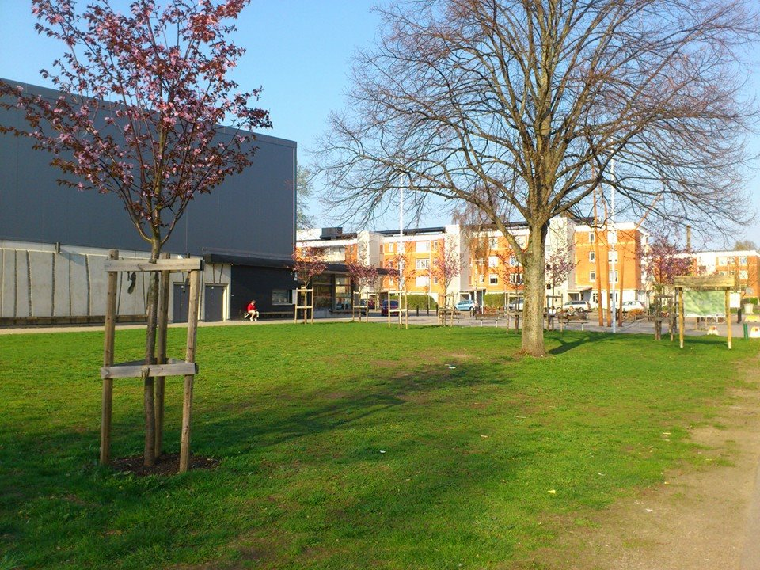
Araby, Växjö

Slide 23
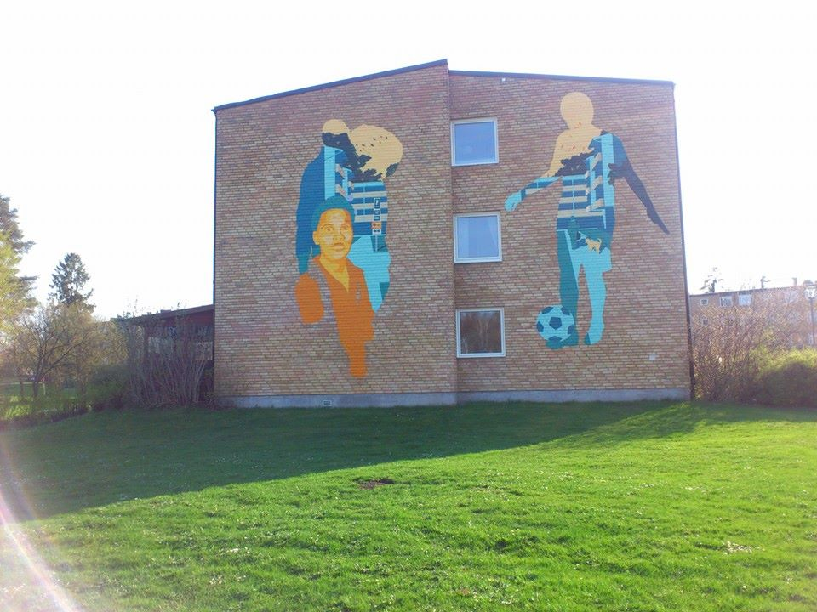
Araby, motive from disposable camera

Slide 24
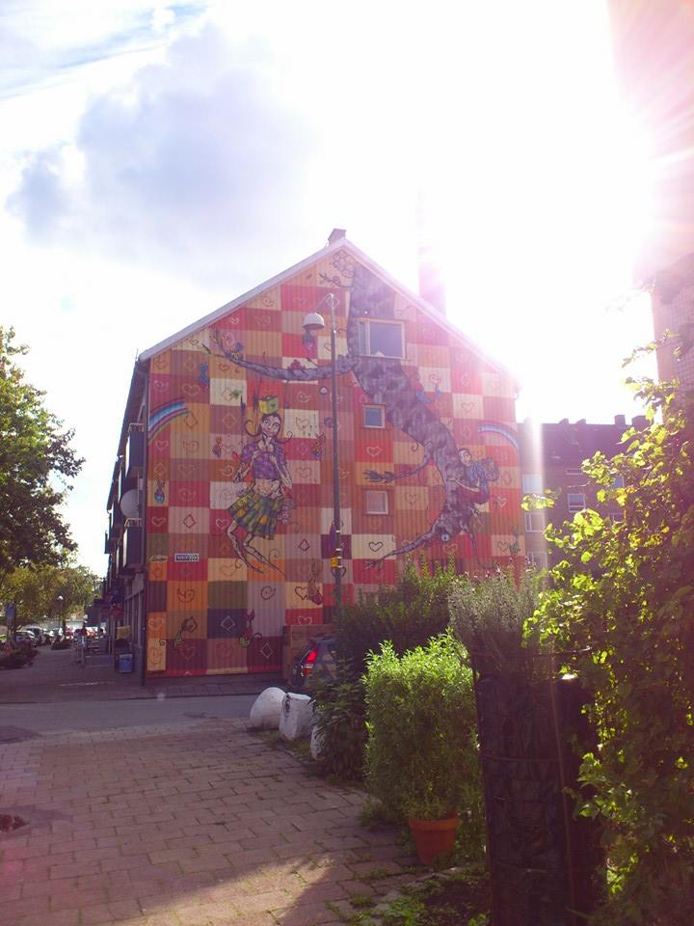
Seved, Malmö

Slide 25
Spatial contingency: FSIC and suburbs
Similarities: Darkening narratives about places
Stories of criminality and danger
Stories of ruins and decline
Stories about people ”being left”
  Welfare dependents
  Passivity, lack of initiative
  Low level of education
  Backwardness, old gender contracts

Slide 26
Shared experiences by inhabitants
Feeling obliged to defend the neighbourhood
Being categorized as something negative
Expressing experience of betrayal (from the state, politicians or local authorities)
Having a more positive view of their place themselves
Speaking about and appreciating cohesiveness
Experience constant mobility as tiresome
Feeling bereaved of their place

Slide 27
Spatial contingency: FSIC and suburbs
Differences
Age structure
Geography and density
Forms of housing
Explanatory models for lacking development:
  Company-town mentality (bruksanda)
  Ethnic/religious otherness

Slide 28
Historical contingency: The colour of fear (Dikec):
The ”Banlieue” originally just defined as ”peripheral”
Working class described as the threat of the suburbs in the 1970’s
”Etnification” of these areas began 1980-1990
Now the areas connotates alterity, insecurity and deprivation

Slide 29
Contingency in time and space both:
Gentrification of earlier stigmatized areas
Examples:
Söder, Stockholm
Möllevången, Malmö
A matter of class

Slide 30
III Darkening of places
Foto: Stockholms stadsmuseum

Slide 31
The two aspects of otherness
The double character of stigma, describing the areas in terms of:
  Danger (the ”dark ditch”)
  Exotisation (the ”white ditch”)
  Both creating a dramatic relationship to the area
  …building otherness

Slide 32
Why darkening of peripheralized places?
The periphery is needed to legitimize and define the centre
A postcolonial relationship between urban and ”rural” reproduces the two aspects of otherness
As a part of a neoliberal agenda and individualization in society as a whole
Places defined as being both out of time and out of place, contamined as ruins of industrial society
On an individual level: everyday management of risks

Slide 33
To what consequences?
Segregation based on class and ethnic origin
Suffering individuals
Overlooking/misrecognition of resources
Concealing economic and social inequality
Impaired conditions for enterprizing and hinders work opportunities
Leaving the places ”open” to exploitation

Slide 34
What has been done?
Trying to exchange people living in these places, to ”better” ones (mixed communities, social mix)
Trying to ”wash” the reputation, building new trademarks
Efforts to change the place physically
A large amount of different projects

Slide 35
The idea of social mix
Has been a popular strategy in urban planning policy
Social mix doesn’t occur as an effect of area based interventions, at least not in Denmark (Christensen, G, 2013)
Can be used as ”gentrification by stealth” (Bridge, Butler & Lees 2012)

Slide 36
Lees et al: Mixed communities- hidden gentrification?
The notion of mixed communities, instead of segregated one’s, is not critizised by the authors.
The policy (top-down) or ”policing” of mixed communities, in the name of diversity, is questioned and critizised.
It is critizised along three lines:
  Policies of social mix are seldom targeted at wealthier areas
  Questioning whether there is a ”real” mix: is physical proximity enough?
  Social mix might as well lead to conflict as well as harmony

Slide 37
To further complicate the picture…
Continue the discussion in the book: Paton 2013 (bringing the working class in)
Questioning the middle class as saviours, since it means
  ”Offering a cultural solution to fix economic and structural issues of poverty”
  the middle class enjoys the mix, but aren’t themselves mixing socially
  Skeggs: ”asset stripping”, taking part in the exotic.

Slide 38
Resistance: Alby-tired of not being recognized
Background: The selling out of public housing
Resistance campaign: ”Alby is not for sale”
A struggle for democracy and a need for trust
”We haven’t been counted for, so we have started to count ourselves”

Slide 39
What CAN be done?
Strategies, base line:
Really striving for change, including own practices and thoughts
Working hard with eventual social and economic problems
Participation

Slide 40
Participation, namely:
  Including the district in the city, striving for connectivity
  Cooperation and relation building, between children and the police f ex.
  Having your ”ear to the ground”
  Appreciate and work with what (and who) is present, not with what ”should” be (anti-gentrification)

Slide 41
Sabina Dethorey, area coordinator, Herrgården, Rosengård:
  ”We wish for no one to come here
  and we wish no one out of here either”

Slide 42
Seemingly best strategies, in order:
Strategic neutralization
Systematic eye-to-eye talks
Physical change – admitting value and recognition
Invitations to come and visit
Own and disseminate information about the area
In order to widen the possibilities to work and live in stigmatized areas

Slide 43
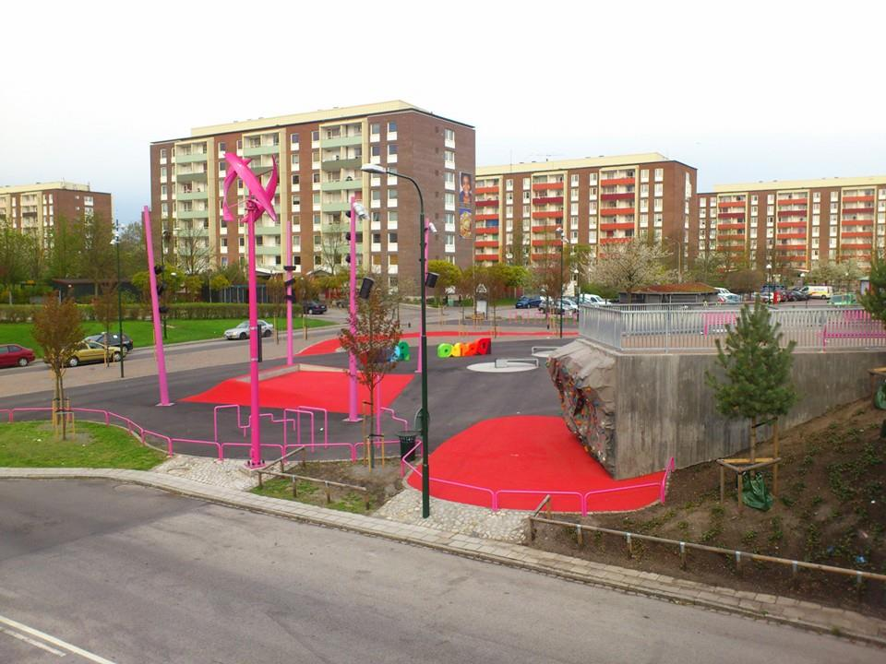
Rosengård : ”the red carpet of the Rose”

Slide 44
Citizens of Malmö in Rosengård
Rosengård as indexical sign and national echoe
Process of change since 2008-2009 riots
Regenerated ”brand” on a local level
    Multifaceted, long term work
    Social responsibility by the municipality, in dialogue with other actors
    The Malmoe commission – for a socially sustainable Malmö

Slide 45
Social sustainable solutions?
The Malmö commission for a social sustainable Malmö
Taking UN:s human rights and world health policys as point of departure
35 research reports
Politically declared and decided for implementation
Taking responsibility for society back

Slide 46
Loic Waquant: Relocating gentrification (2008)
“For, as Tedd Gurr and Desmond King (1987: 4) reminded us two decades ago, ‘those who hold and use state power can allow the fate of cities to be determined mainly in the private economy, but that is a matter of public choice rather than iron necessity.’” (p 208)

Slide 47
Thank you for listening!
maria.vallstrom@hufb.se
maria.vallstrom@sh.se

