Slide 2
Life-cycle assessment (LCA)
An attempt to evaluate the environmental impacts of a product or service for the whole life of the product or service – ’from the cradle to the grave’
OR:
An attempt to evaluate the environmental impacts of a product or service on the basis of all the natural resource inputs and emissions to the environment arising from the complete supply chain for that product or service.

Slide 3
Key questions in LCA
1. What is your product/service (in quantitative terms!) (called functional unit)
2. What emissions to and resource demand from the environment is necessary for the identified product/service? (called Life-Cycle Inventory)
3. How do these processes affect the environment? (called Life-Cycle Impact Assessment)

Slide 4
1. Functional Unit
Quantified measure of the function of the product or service
Used as a reference for all alternatives
Must be the same for LCA-based comparisons
Drinks packaging
”Packing for 100 litres of water such that it can be stored hygienically and safely and be transported and sold to the consumer”
(NOT: 50 cl Glass bottle vs. 33 cl aluminium can)
Vehicle fuel
”Fuel to drive 100 km with a Volvo V50”
(NOT: 1 litre ethanol vs. 1 litre petrol)
Buildings
”1 m² heated floor area for 50 years” or ”Residence for 12 people for 50 years”
Notes:
Fråga!
Låt dem diskutera, sedan svara.

Slide 5
2. Life-cycle Inventory
Break this down into two simpler questions:
What are the processes involved in the production of your product/service?
What are the emissions/resource demands for each of the processes?

Slide 6
Question 2a. What processes?
Watch this film:
https://www.youtube.com/watch?v=eg-E1FtjaxY
Note down: as many separate non-transport processes as you can that are involved in the production of the spoon

Slide 7
Oil search
Extract- ion
Refin- ery
T
T
T
Pellet factory
Mould-ing
Shop
Party!
End of life
T
T
T
T
Transport

Slide 8
Emissions: CO2, CH4, SOx, NOx, Hydrocarbons, nitrates, phosphates heavy metals, organic toxins, dioxins
Oil search
Extract- ion
Refin- ery
T
T
T
Pellet factory
Mould-ing
Shop
Party!
End of life
T
T
T
Resources: Oil, minerals, metal ores, wood, cement, sand, gravel, water …..

Slide 9
Question 3: Life-cycle Impact Assessment
Results of the Inventory:
We know what is taken (resources) from the environment
We know what is put into the environment (emissions)
Life-cycle impact assessment asks what effect the ’takes’ and the ’puts’ actually has on the environment

Slide 10
Emissions: CO2, CH4, SOx, NOx, Hydrocarbons, nitrates, phosphates heavy metals, organic toxins, dioxins
Characterization
Oil search
Extract- ion
Refin- ery
T
T
T
Impacts in the environment
LCIA
Pellet factory
Mould-ing
Shop
Party!
End of life
T
T
T
Classification
Resources: Oil, minerals, metal ores, wood, cement, sand, gravel, water …..

Slide 11
Characterization
Emissions: CO2, CH4, SOx, NOx, Hydrocarbons, nitrates, phosphates heavy metals, organic toxins, dioxins
Impacts in the environment
LCIA
Resources: Oil, minerals, metal ores, wood, cement, sand, gravel, water …..
Classification

Slide 13
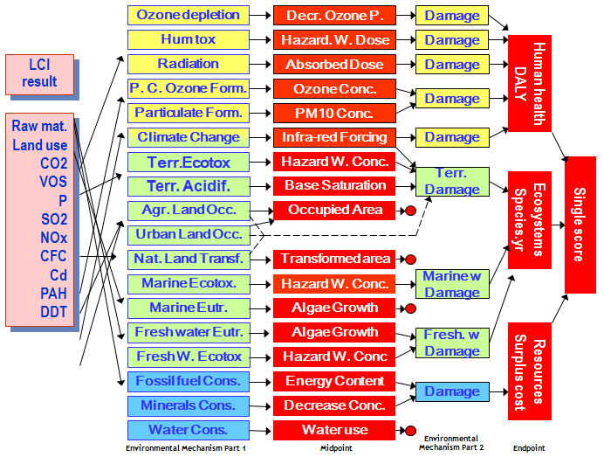
ReCiPe, Goedkoop et al, 2009
1. Classification
2. Characterisation
Notes:
End point structure similar to Eco-indicator 99

Slide 14
Typical Impacts
Typical impacts considered include:
Global Warming Potential (GWP)
Ozone Depletion Potential (ODP)
Human Toxicity Potential (HTP)
Ecotoxicity Potential (EP)
Acidification Potential (AP)
Photochemical Ozone Formation Potential (POFP)
Eutrophication Potential
Abiotic Resource Depletion
Agricultural Land Use

Slide 15
ReCiPe, Goedkoop et al, 2009
1. Classification
2. Characterisation
Notes:
End point structure similar to Eco-indicator 99

Slide 16
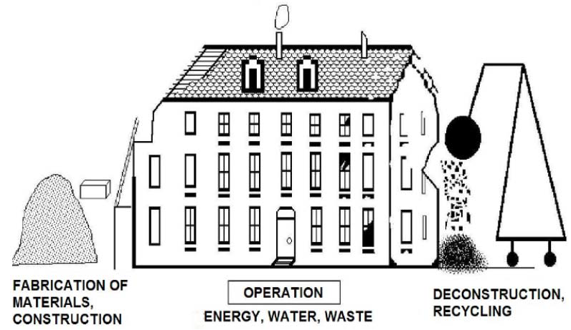
LCA for buildings
Functional Unit:
”1 m² heated floor area for 50 years” or ”Residence for 12 people for 50 years”
Processes for consideration in inventory:
Once inventory of emissions and resource demands compiled, impact assessment can be performed using generic methods

Slide 17
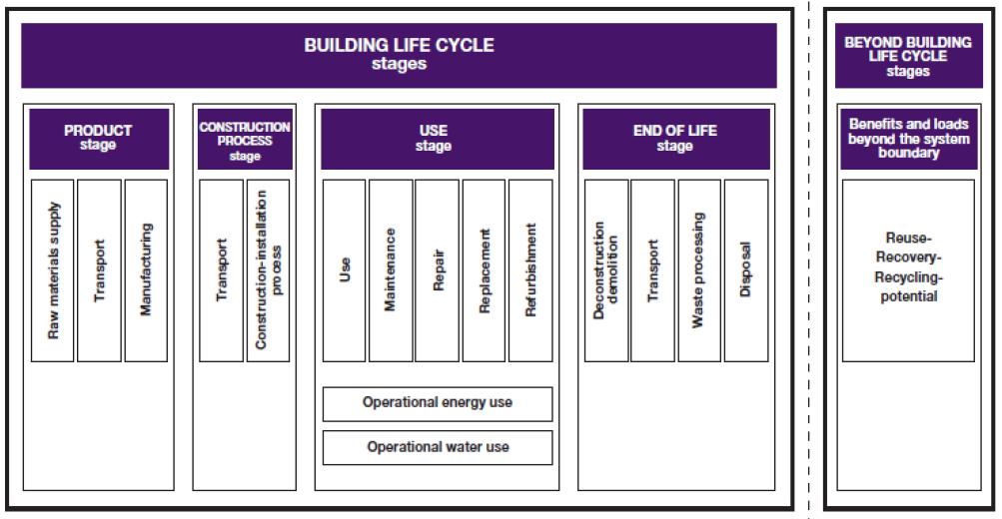
Generic Inventory Processes for Buildings – EN Standards 15804 and 15978

Slide 18
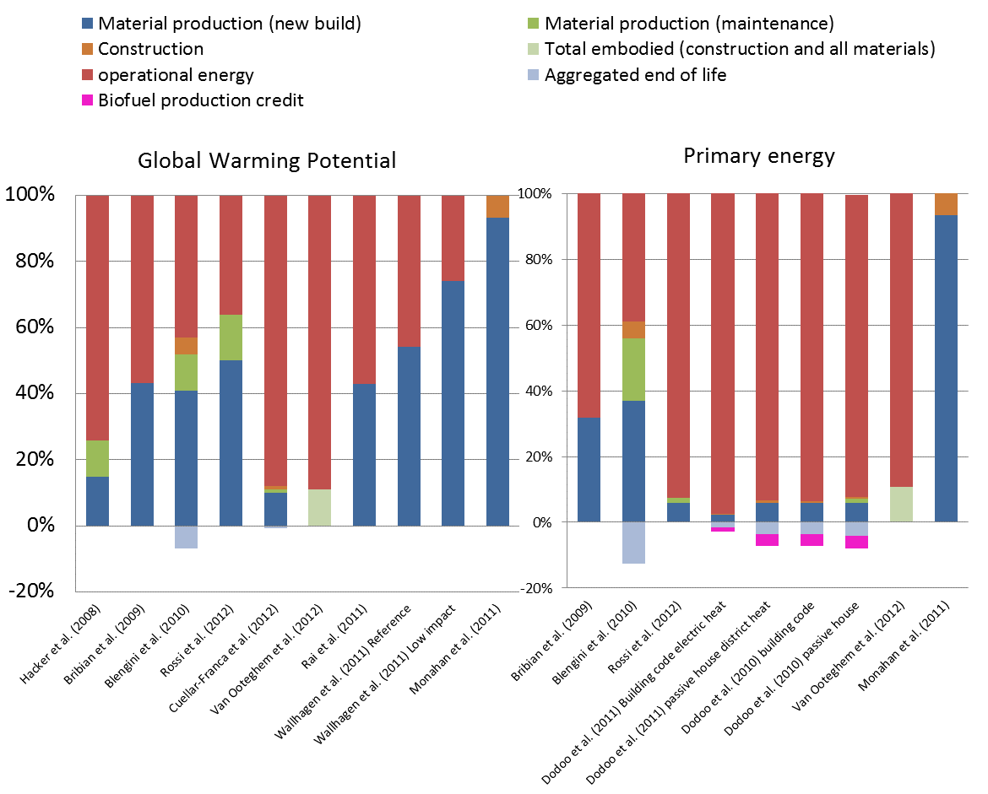
A summary of studies for impact categories GWP and PE

Slide 19
Simplified LCA procedure
Often called ”life-cycle approach” to avoid confusion with an assessment that follows all rules for LCA according to ISO standard
Assess two processes:
Product stage
Operational energy in use stage
One impact category:
Global Warming Potential

Slide 20
Interested in LCA?
Jeans !:
http://levistrauss.com/wp-content/uploads/2015/03/Full-LCA-Results-Deck-FINAL.pdf
Building materials and more (EPDs):
http://www.environdec.com/
Courses:
AG2800: LCA course
AG2806: Environmental aspects of the built environment

